Slide 1







ANALYSIS OF SONG POPULARITY FROM
Team 2

Slide 2







Meet our amazing team
Amily Luo
Hassanat Awodipe
Scotland
Ballet, Talking to Cats, Baby of the Team
Italy
Fashion Designing, Story Writing, Cycling
Madina Baimaganbetova
Alisa Yanovski
Blessing Ogechi Nwojiji
Kazakhstan
Swimming, Solving Riddles, Traveling
Spain
Mum & Scholar, Jogging, Mama of Team
Nigeria
Loves to learn, Dancing, Keeping Fit

Slide 3






How we Collaborated
We used Agile-Scrum Methodology
Chat and messaging on slack
Google Meet and Google doc
Google Colab
Project Management: Jira
Version Control: GitHub

Slide 4



What would be the factors that affect a song’s popularity?
How would these factors affect a song's popularity?

Slide 5




STEPS SPECIFICATION
Data Gathering
Spotify API
Kaggle
Wikipedia
Azlyrics
Data Pre-processing
In-depth Analysis
Analysis
Visualisations
Insights

Slide 6



Python and Analytical Libraries:
Pandas
Matplotlib
Seaborn
Selenium
Wptools
bs4
Numpy
Spotipy...
Analytics Tools

Slide 7

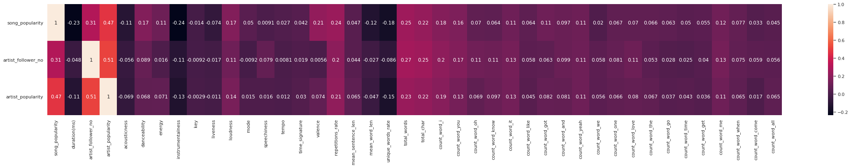
Heatmap of Numerical Features

Slide 8

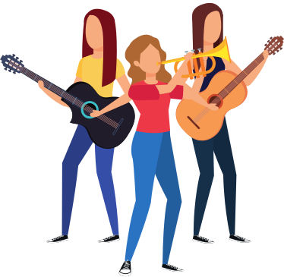
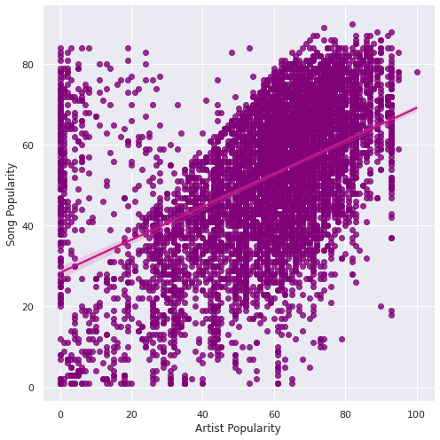
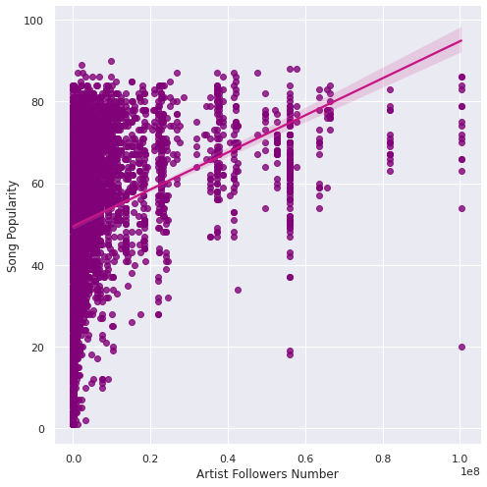
Artist Popularity VS Song Popularity

Slide 9


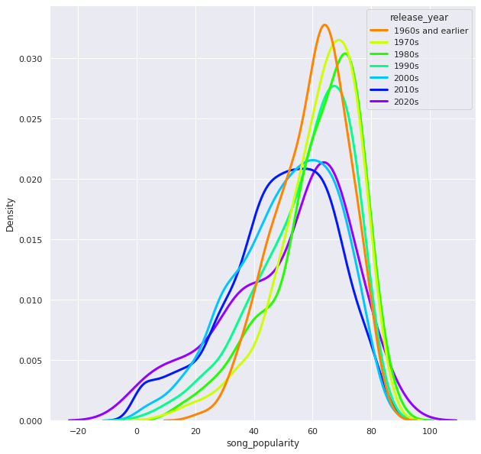
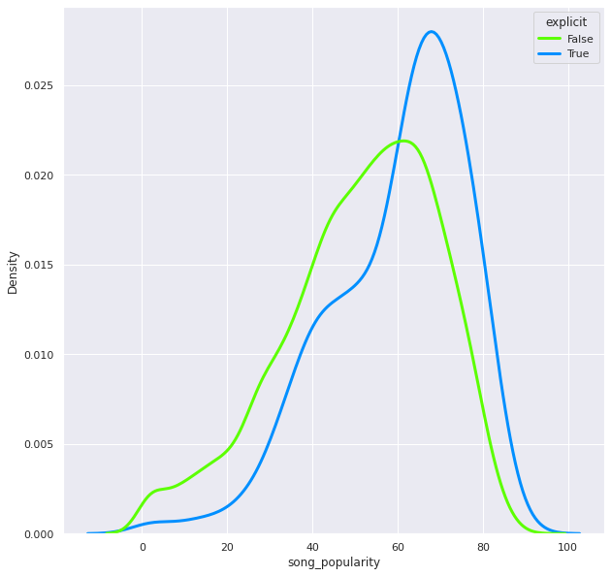
Release Time, Explicit VS the Song Popularity

Slide 10

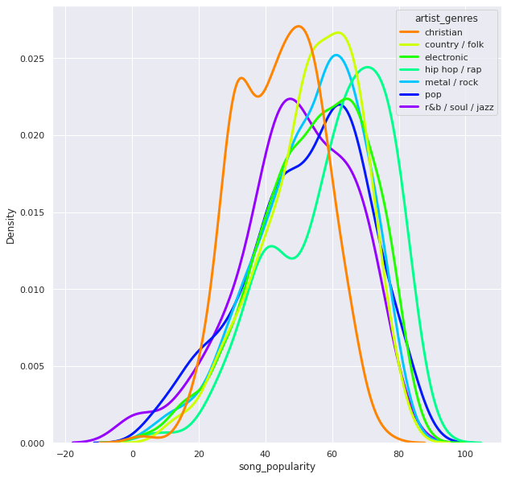
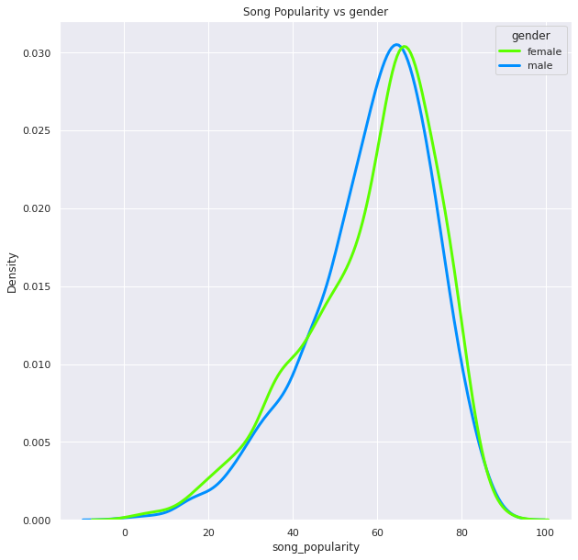
Artist Genre and Gender Vs Song Popularity

Slide 11

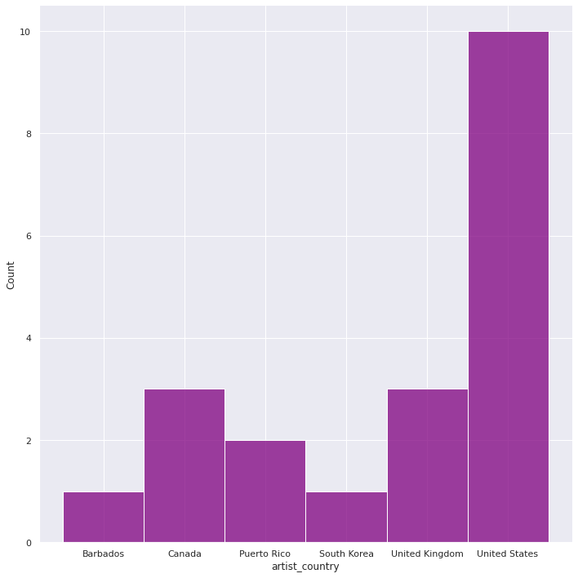
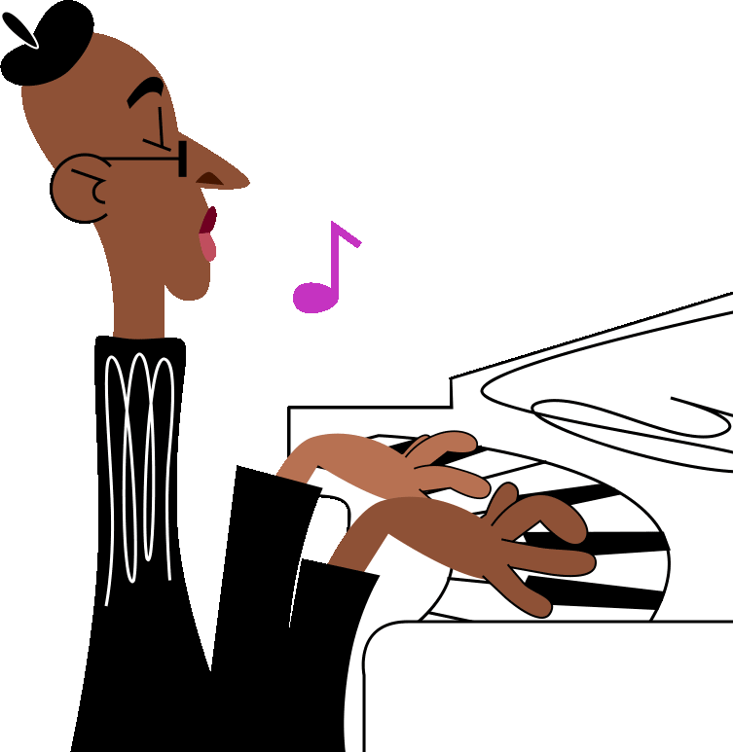
Most Popular Artist Country

Slide 12
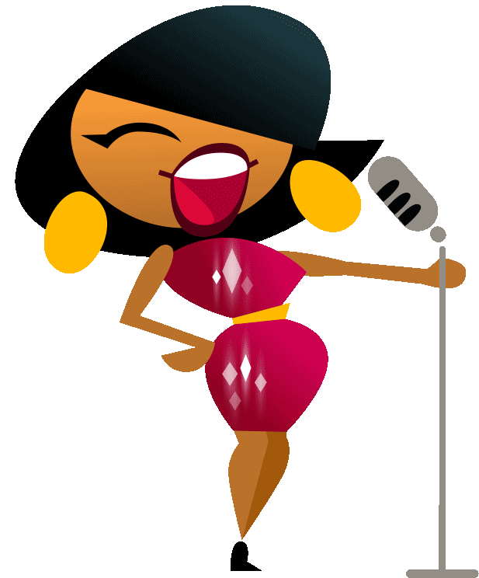
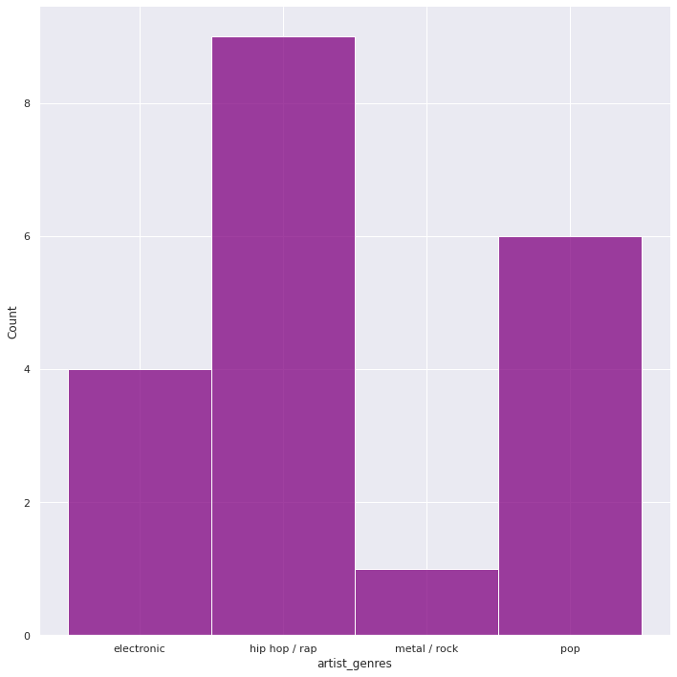
Most Popular Artist Genre

Slide 13

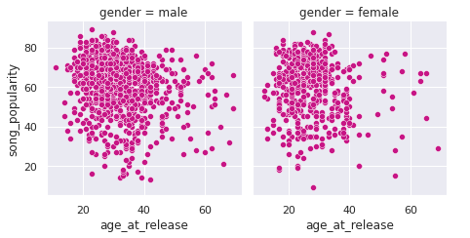
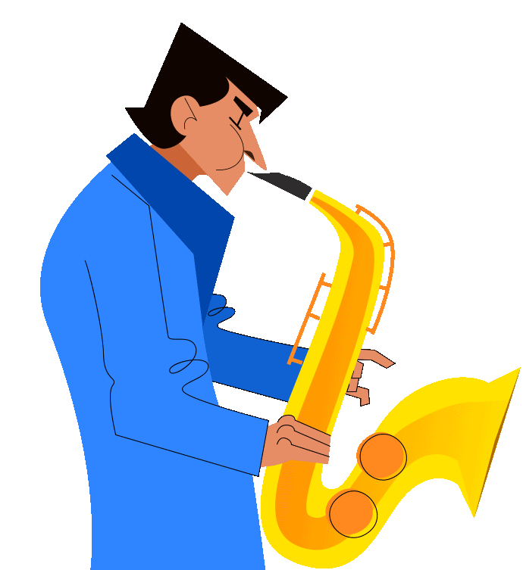
Age at Release

Slide 14

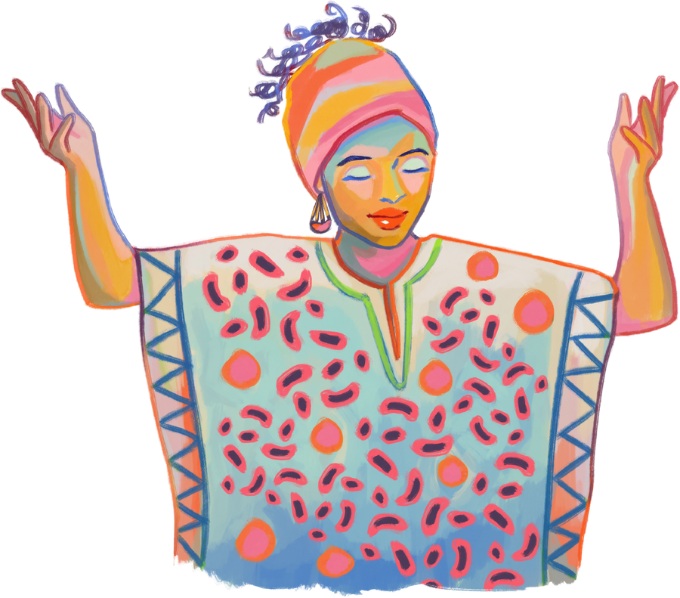
CONCLUSION
Factors that affect
Artist popularity
Artist followers number
Song release year
Genre
Explicity
Country
Group (band)
Factors that don't affect
Lyrics
Gender
Country
Age at release
Duration

Slide 15

